Slide 1



Migrating to Linux: A Proposal for Faster Computing CMIT 391 6392 Micah L. Martinez 02 Feb 2021
Notes:
Good afternoon, I’m <insert name here> of Go2Linux.
Today, I’ll be narrating my proposal for Faster Computing.
I’ll present my recommendations for migrating Faster Computing to Linux.

Slide 2
Benefits
Low Cost
Secure
Stable
Compatible with most hardware
Large Support community
Notes:
There are a number of benefits for Faster Computing in migrating to Linux, to include:
- Justification #1 [1];
- Justification #1;
- Justification #3;
- Justification #4 [2];
<Enter additional verbiage as needed>

Slide 3
Recommendation: Mint
Security
Is based off highly secure and stable Linux Distributions
Effective Software Management
Suitability
Support
Long Term Support
Has a Graphical User Interface (GUI) that is similar to Windows
Works well with older hardware
Compatible with open-source and proprietary software including Windows and Mac Software
Notes:
Go2Linux recommends <enter distro here> for Faster Computing. <Enter distro here> is a <enter verbiage here>.
Be specific on the version of Linux (e.g., Ubuntu, Mint, Zorin, Redhat, CentOS, Kali) and give specific reasons for your choice (e.g., security features, support, updates, user interface).
Support <enter verbiage here>.
Suitability <enter verbiage here>.

Slide 4
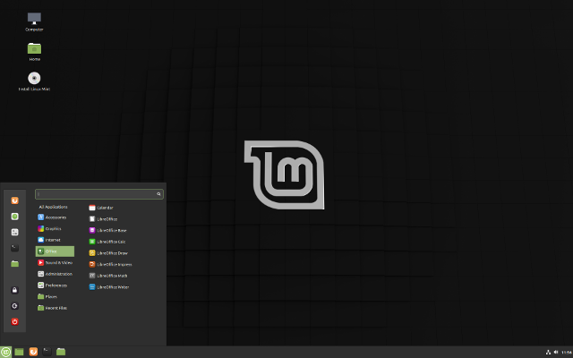
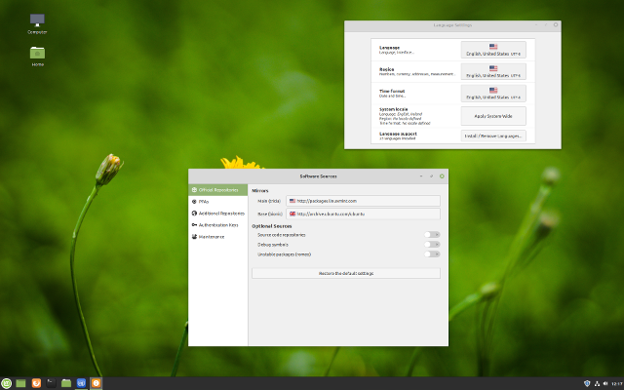
The User Desktop (Mint)
Notes:
Typical GUI installation of <enter distro here> showing <enter application here> and the <enter application here>.

Slide 5
Recommendation: Debian
Security
Widely known for stability and security for over 20 years
Suitability
Support
Participates in security standardization efforts
The seed/base of many other Linux Distributions, including Mint
Provides Long Term Support
Extensive hardware support
Security Audit team actively looks for security bugs
Highly regarded for being easy to maintain

Slide 6
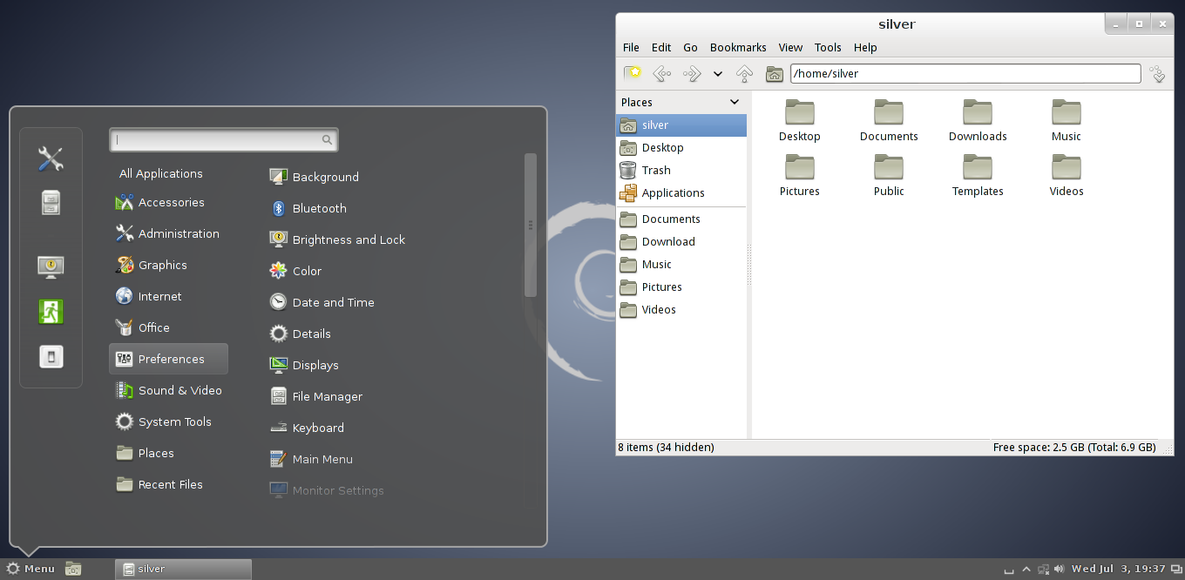
The User Desktop
Notes:
Typical GUI installation of <enter distro here> showing <enter application here> and the <enter application here>.

Slide 7
Migration Steps
Hardware
Software
Test and Train
Backup
Pilot
Notes:
Explain your migration methodology. This is only an example.

Slide 8
Tools to provide file sharing, services, and printing
File Sharing
Samba
Wine
Printing
Samba
Services
CUPS
Libre Office
Apache
OwnCloud
SyncThing
ZenMap
Notes:
What tools are available on Linux for the servers to provide file sharing, Linux services, and printing? (e.g., Apache/Nginx, Samba, CUPS, SSH/SCP).
Ensure you identify what the functions/services are used for (e.g., Samba is used for file sharing).
Discuss the tools that can be used on Linux servers, identify the functions, and explain what those functions are used for.

Slide 9
Summary
Linux is fast, secure and reliable across many different hardware combinations.
Most Linux distributions have a graphical user interface.
Large support communities.
Large variety of software packages
Generally easy to use and learn.
Notes:
In summary, my proposal has demonstrated why Faster Computing should migrate existing computers to <enter Distro here>.
Summarize your main points. It’s your last opportunity to connect with your client.
Why should the company should adopt Linux? Why did you recommend the distro you chose?
Will hardware upgrades be required?
How will the migration work?
Is the GUI similar to existing Windows based computers?
Are there any CLI considerations and what tools did you recommend?
<Salutation>

Slide 10
References
[1] Apache, "The Apache Software Foundation," 2020. [Online]. Available: http://www.apache.org/. [Accessed 1 February 2021].
[2] Samba, "Samba," 26 January 2021. [Online]. Available: https://www.samba.org/samba/. [Accessed 1 February 2021].
[3] SyncThing, "SyncThing," 2021. [Online]. Available: https://syncthing.net/. [Accessed 1 February 2021].
[4] OwnCloud, "OwnCloud," 2021. [Online]. Available: https://owncloud.com/. [Accessed 1 February 2021].
[5] CUPS, "CUPS," 24 April 2020. [Online]. Available: https://www.cups.org/. [Accessed 1 February 2021].
[6] Linux Mark Institute, "Linux Mint," January 2021. [Online]. Available: https://linuxmint.com/. [Accessed 1 February 2021].
[7] Software in the Public Interest, Inc., "Debian," 9 January 2021. [Online]. Available: https://www.debian.org/. [Accessed 1 February 2021].
[8] Wine, "Wine HQ," 29 January 2021. [Online]. Available: https://www.winehq.org/. [Accessed 1 February 2021].
[9] G. Lyon, "ZenMap GUI," January 2021. [Online]. Available: https://nmap.org/zenmap/. [Accessed 1 February 2021].
Notes:
The example above uses IEEE style. Ask your instructor for clarification on the style to be used.

